Slide 1



Low Frequency Prototype of Laser Interferometer Suspensions for Gravitational Wave Detection
Presentation By: Yuka Lin
Mentor: Dr. Michele Zanolin (Department of Astronomy & Physics)
Embry-Riddle Aeronautical University
Acknowledgements: Dr. Darrel Smith (Embry-Riddle Aeronautical University), Dr. Gabriele Vajente (California Institute of Technology), Dr. Anne Boettcher

Slide 2
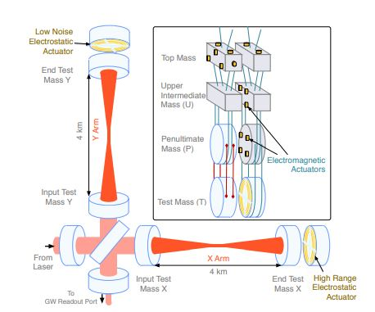
LIGO = Laser Interferometer Gravitational-Wave Observatory
https://www.researchgate.net/figure/Left-panel-LIGO-Hanford-site-USA-The-two-arms-of-the-
interferometer-are-about_fig3_331246187
https://arxiv.org/abs/1710.09973

Slide 3
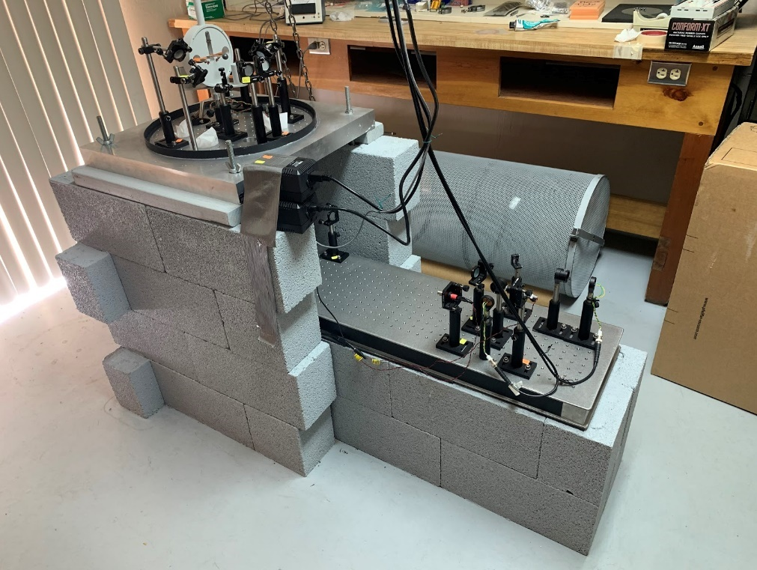
Experimental Model Set-Up
Torsion Pendulum
Upper Optics Bench
Lower Optics Bench

Slide 4
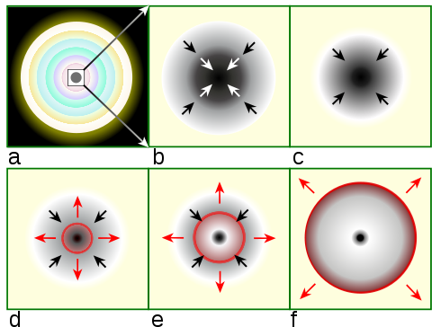
The overall goal of this project: detecting gravitational waves (GW’s) in the low frequency regime (below 10 Hz)
https://en.wikipedia.org/wiki/Type_II_supernova
Essentially, this regime is where the supernovae core-collapse and pre-merger binary star mergers are relevant.

Slide 5
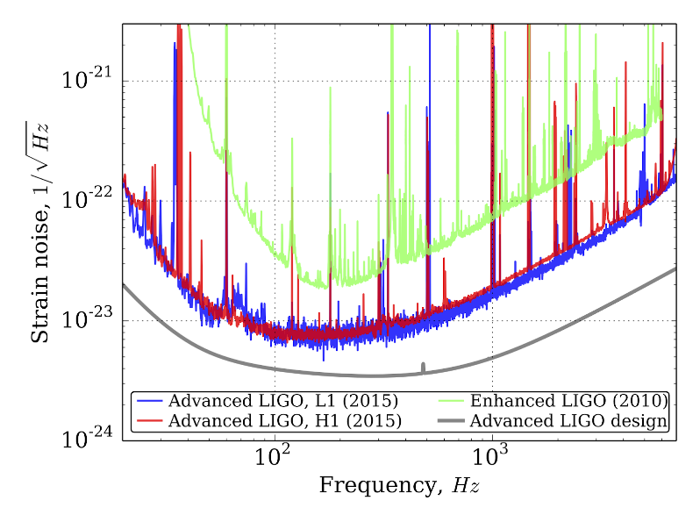
Detector Sensitivity
The graph shows the level of strain noise that LIGO detectors can detect. The lower the lines, the more sensitive the detectors are.
https://arxiv.org/abs/1604.00439

Slide 6
The Main Problem
It is extremely difficult to detect GW’s in the low frequency regime since they would be obscured by external noise (i.e. ground vibration) that will interfere with the suspended test masses
However, there are methods to possibly reduce the noise

Slide 7
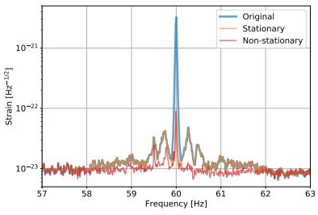
Noise Subtraction
Algorithms from machine-learning techniques were created to reduce the non-stationary noise couplings from the detector output.
https://arxiv.org/abs/1911.09083

Slide 8
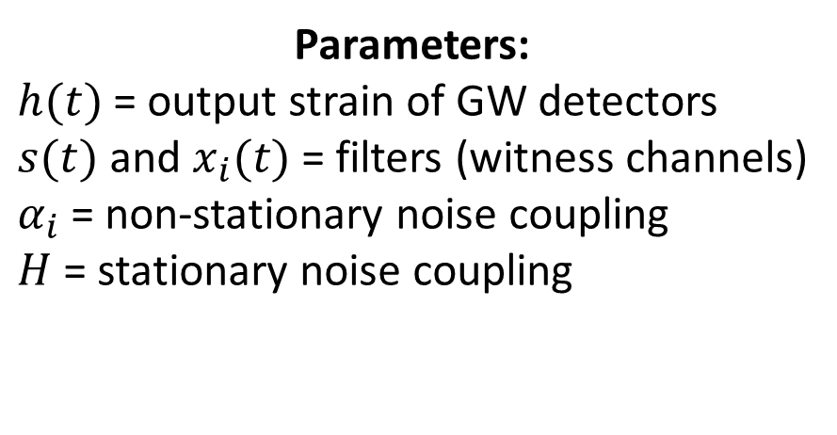
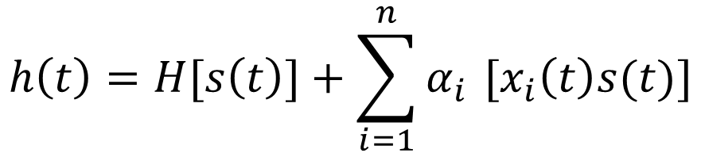
Noise Subtraction
$$h\left(t\right)=H[s\left(t\right)]+\sum_{i=1}^{n}{α_{i }}[x_{i}\left(t\right)s(t)]$$
Parameters:
$h(t)$ = output strain of GW detectors
$s(t)$ and $x_{i}(t)$ = filters (witness channels)
$α_{i}$ = non-stationary noise coupling
$H$ = stationary noise coupling

Slide 9
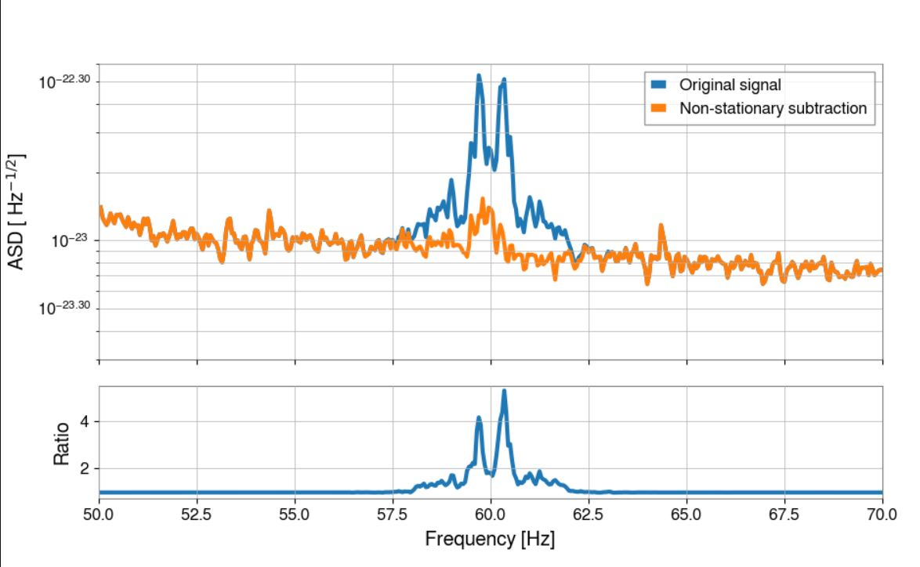
Example Output for 60 Hz Powerline:
The full code for the algorithm: https://git.ligo.org/gabriele-vajente/nonsens

Slide 10
References
Martynov, D. V. et al. “Sensitivity of the Advanced LIGO Detectors at the Beginning of Gravitational Wave Astronomy.” Physical Review D 93.11 (2016): n. pag. Crossref. Web.
Type ii supernova. (2021, March 28). Retrieved April 02, 2021, from https://en.wikipedia.org/wiki/Type_II_supernova
Vajente, G., Huang, Y., Isi, M., Driggers, J., Kissel, J., Szczepanczyk, M., &amp; Vitale, S. (2020, January 28). Machine-learning non-stationary noise out of gravitational wave detectors. Retrieved April 02, 2021, from https://arxiv.org/abs/1911.09083
Viets, A., Wade, M., Urban, A., Kandhasamy, S., Betzwieser, J., Brown, D., . . . Weinstein, A. (2018, March 13). Reconstructing the calibrated strain signal in the advanced ligo detectors. Retrieved April 02, 2021, from https://arxiv.org/abs/1710.09973

Slide 11
Questions?
Contact:
liny10@my.erau.edu

